Slide 1

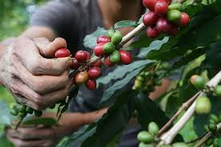
Coffee Quality Analysis
Loknath Panada

Slide 2



Introduction
C.Q.I
The Coffee Quality Institute (CQI) is a non-profit organization working towards quality improvement and value addition of coffee worldwide.
The organization works with coffee growers, processors, roasters, and other stakeholders.
Promote coffee quality through research, training, and certification programs.

Slide 3
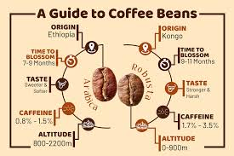
Data Understanding
C.Q.I
C.Q.I
The data contains sensory attributes that helps in rating the coffee quality based on Aroma, Flavor, Aftertaste, Acidity, Body, Balance, Uniformity, Clean Cup and Sweetness.
Category One and Category Two are the two defects categories to grade Coffee quality.
Category One defects are primary defects that can be perceived through visual inspection.
Category Two defects are secondary defects that are more subtle and can only be detected through tasting.

Slide 4
Data Preprocessing and Feature Engineering
C.Q.I
C.Q.I
Removed columns that were not important for analysis.
Checked for the duplicate values by selecting through all columns and removed one row as important features(altitude, variety, region) were blank.
Took mean value of altitude for our analysis.
Converted “Chinese” language to English using google converter improving readability.
For harvesting years 2022/2023 took the later one assuming harvesting competed in final year.
Formatted grading date datatype by replacing “st”, “nd”, “rd”, “th” by null.
Replaced categorical null values with “Unknown”.
Created new columns “moisture percentage group”, “altitude range” and “total defects” to group feature values for effective visualization.
Created measures “total cup points”, “total bag weight” and “total sum defects”.

Slide 5
Objective
C.Q.I
To find key determinants of coffee quality as evaluated through sensory attributes such as aroma, flavor, acidity etc.
To Identify correlation between processing methods, origin regions, and coffee quality scores
To extract trends or patterns in defect occurrences and their impact on overall coffee quality.
To visualize how different variables interact to influence the Total Cup Points.

Slide 6
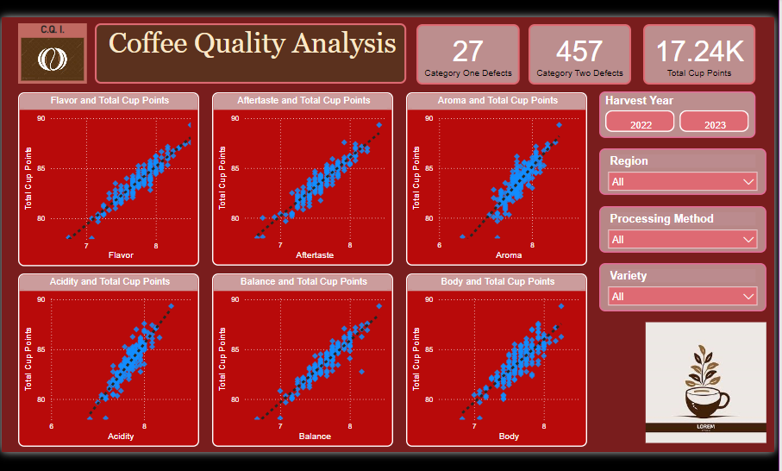
C.Q.I

Slide 7
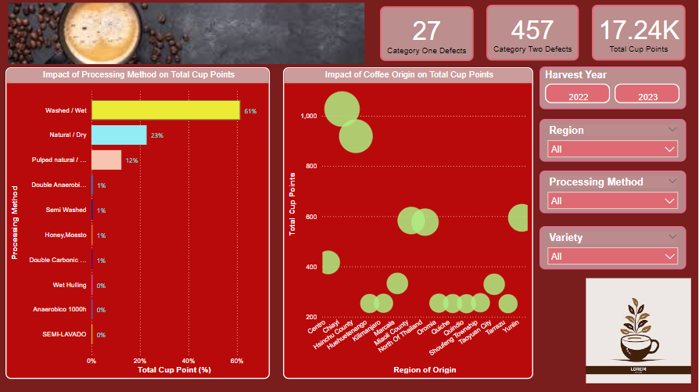

Slide 8
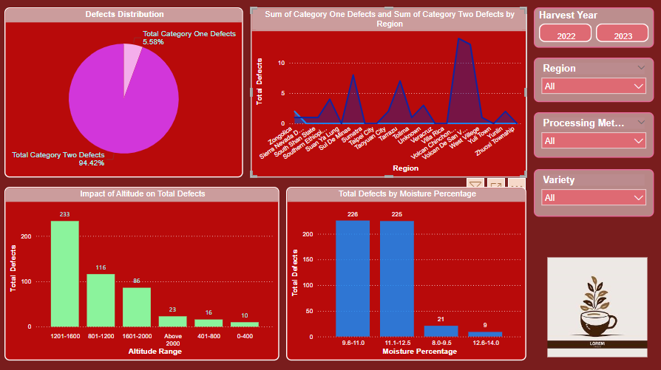

Slide 9
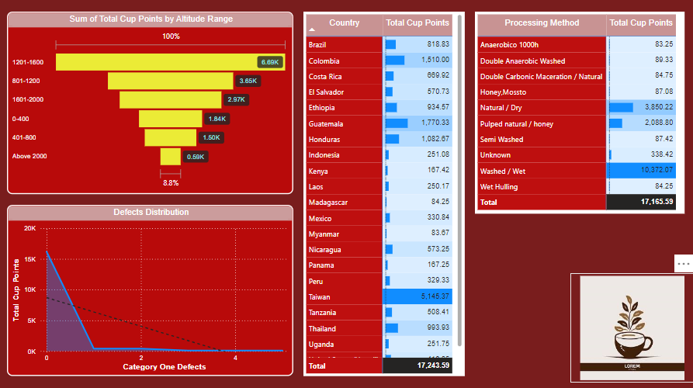

Slide 10

Insights
C.Q.I
All sensory attributes are linearly correlated with Coffee quality.
Washed/wet is the widely adapted processing method followed by natural dry and the Pulped dry/honey treatment methods also the coffee quality has been rated highest amongst all.
Coffee quality of Chinyi region is at the top contributing to highest cup points.
The regions situated above the altitudes of 1200m have been Most number of defects have been detected across bag samples coming from higher altitude regions above 1200m.
The coffee bins containing moisture levels above 9.5% are prone to damage.
The category one and category two defects have direct impact on total cup points thus pointing towards reduced coffee quality than standards.

Slide 11

Conclusion
C.Q.I
Washed/Wet processing method results into higher cup points thus adapting this widely accepted method and combining it with other processing methods can reduce the count of defects.
For higher altitude regions training harvesters on washed/wet processing method and driving awareness of storage conditions to maintain moisture percent below 9.5 can significantly reduce the type one and type two defects resulting into improved coffee quality.
Researching techniques to detect potential Type II defects early during the grading process can significantly reduce processing costs and time, while preventing contamination of other samples, especially when bins from different regions are combined

